Slide 1
Second Review
A Unified NLP-Driven Model for Detecting Fake News in Multiple Languages
Batch No - 260
Guide details:
Mrs . N. Mounika
Asst.Prof
Dept of CSE
Presented By :
221FA04462 Sk.Rehana Sultana
221FA04686 G.Keerthi Lakshmi

Slide 2
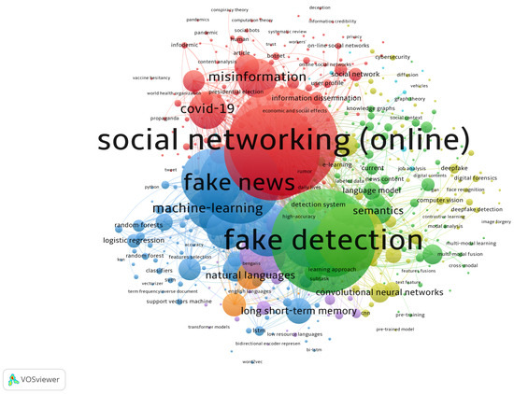
INTRODUCTION
Fake news spreads rapidly across digital platforms, creating misinformation that affects society and global communication.
Existing detection systems are mostly language-specific, making it difficult to identify fake news across diverse languages.
This project develops a multilingual fake news detection system using advanced NLP techniques to classify news as real or fake.

Slide 3
Objective:
To develop an automated system that accurately detects fake news across multiple languages.
To apply advanced NLP and machine learning techniques for effective text analysis and classification.
To create a scalable and reliable model that helps reduce the spread of misinformation globally.
GitHub Repository:

Slide 4
Dataset Statistics:
Data Set: Multilingual Fake News Detection
Source: Kaggle
Split:
Training data: 75%
Testing data: 25%
Component | Samples
Total Training Samples | 75,000
Initial Labeled | 15,000
Initial Unlabeled | 60,000
Samples Added per Cycle | 200
Maximum Iterations | 150
Component | Samples
Total Test Samples | 24,409
Labeled Samples | 24,409
Unlabeled Samples | 0
Evaluation Cycles | 1
Final Accuracy Check | Yes
Testing Samples
Training Samples

Slide 5
First Review Progress:
Problem identification and formulation of Fake News Detection as a binary and multi-class text classification problem (Kaggle Dataset– Real/Fake).
Literature survey on transformer-based deep learning architectures (BERT, RoBERTa, DistilBERT, ALBERT, DeBERTa) used for efficient News classification.
Dataset selection (Kaggle Dataset – public benchmark datasets) and understanding of text characteristics, class distribution, and real-world relevance in opinion mining and social media analysis.
Data preprocessing steps:
Text cleaning (removal of URLs, special characters, emojis)
Lowercasing and normalization
Tokenization using transformer tokenizers
Handling class imbalance (if required)
Dataset splitting (Train,Test – 75/25)
Initial model selection and feasibility analysis: Selection of pre-trained transformer models for fine-tuning Comparison of Baseline Models (Logistic Regression,Svm) vs heavyweight models (mBERT, Xlm-RoBERTa,Labase)
Preparation of First Review PPT including:
Abstract
Objectives
Proposed Methodology

Slide 6
Second Review Progress:
Contextual Feature Extraction Using Transformer-based Language Models
Extraction of deep contextual word and sentence embeddings from multilingual transformer encoders.
Implementation of multiple Transformer models:
mBERT xlm-RoBERTa DistilBERT Paraphase MultiLingual
Development of Multilingual Fake News Detection Framework
End-to-end multilingual pipeline using transformer embeddings.
Seamless handling of cross-lingual data using shared vocabularies and sentence encoders.
Designed to classify news into binary or multi-class outputs depending on dataset.
Model training and performance comparison across binary classification dataset
• Hyperparameter tuning:
Learning rate optimization Batch size tuning Number of training epochs selection Maximum sequence length adjustment

Slide 7
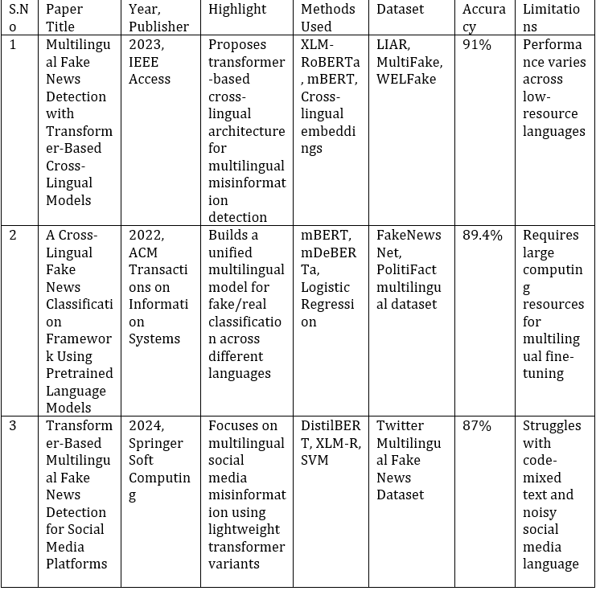
Literature Survey

Slide 8
Performance Evaluation of the Proposed Model
The proposed Multilingual Fake News Detection Framework using Transformer Models was evaluated using multiple quantitative performance metrics to ensure high accuracy, multilingual robustness, and reliable fake news classification. The datasets consisted of:
Binary Fake News Classification : Real, Fake
The evaluation metrics included:
Accuracy
Precision
Recall
F1-Score
Confusion Matrix
ROC-AUC
Across all tested models, XLM-RoBERTa achieved the highest performance, with an overall accuracy of approximately 94% on the multilingual fake news dataset. It outperformed other transformer models including:
mBERT
Distiluse
LaBSE
Paraphase Multingual model

Slide 9
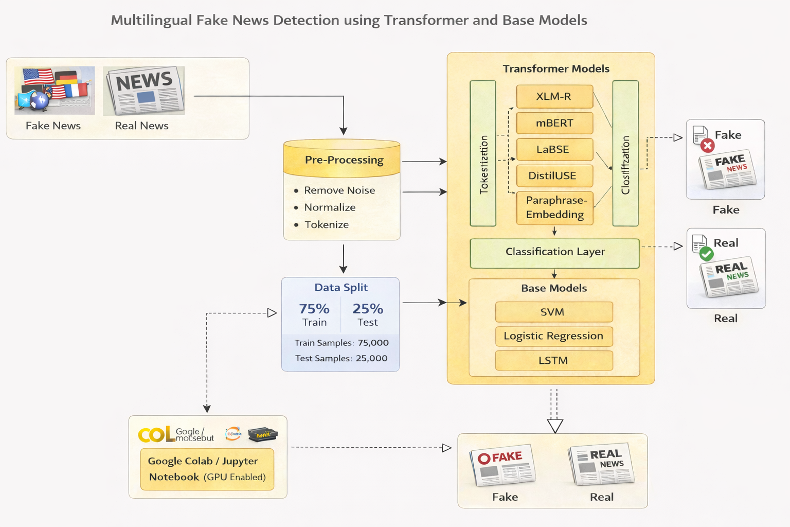
Proposed System Architecture

Slide 10
Methodology
Dataset Collection
Collect multilingual fake news datasets containing labeled samples such as Real, Fake, Partially Fake, and Misleading.
2. Data Cleaning
Remove noise such as URLs, emojis, special characters, HTML tags, and unnecessary punctuation.
3. Text Normalization
Apply lowercasing, whitespace normalization, and standardize multilingual text formats.
4. Tokenization
Use transformer-based multilingual tokenizers to convert text into input tokens.

Slide 11
Data Splitting
Divide the dataset into training, validation, and testing sets (e.g., 80/10/10).
6. Model Selection
Choose transformer models like mBERT, XLM-RoBERTa, and DistilmBERT for fine-tuning.
7. Model Training
Train the selected models on the processed multilingual dataset to learn contextual fake news patterns.
8. Model Evaluation
Evaluate performance using metrics such as Accuracy, Precision, Recall, F1-score, Confusion Matrix, and ROC-AUC.

Slide 12
Tools & Learning Status
Content:
Programming: Python
Libraries: NumPy, Pandas, Scikit-learn, PyTorch, Transformers
Platform: Google Colab (GPU Enabled)
Visualization: Matplotlib, Seaborn
Dataset Handling: Kaggle Dataet
Learning Status:
Completed basics of NLP and Transformers
Learned Base models and Transformer models
Understood fake news classification techniques and evaluation metrics

Slide 13
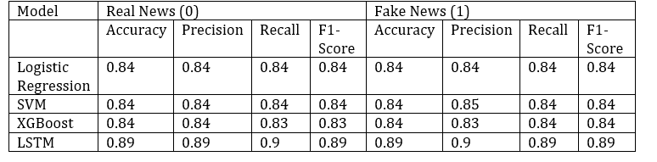
Class Wise Performance of Base Models

Slide 14
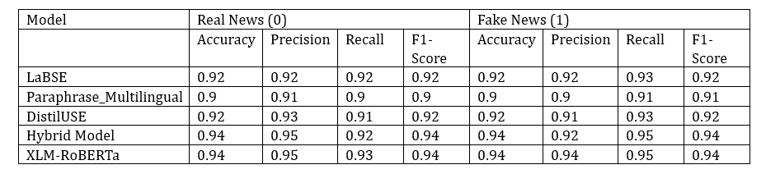
Class wise Performance of Transformer Models

Slide 15
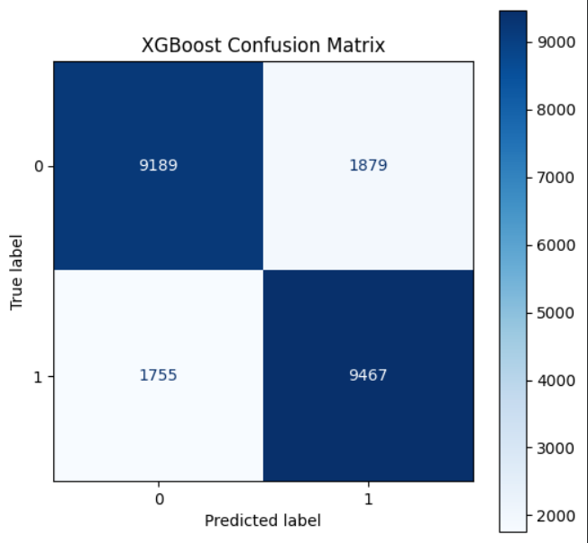
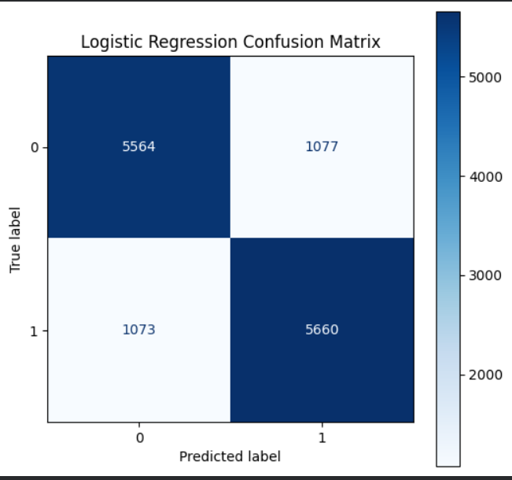
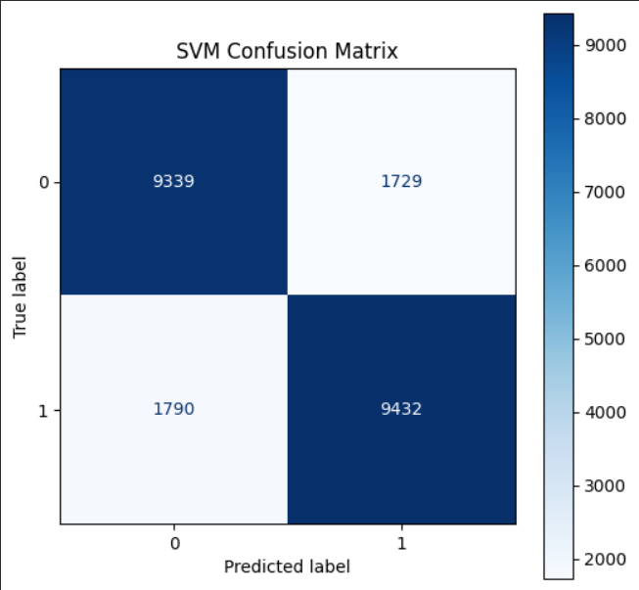
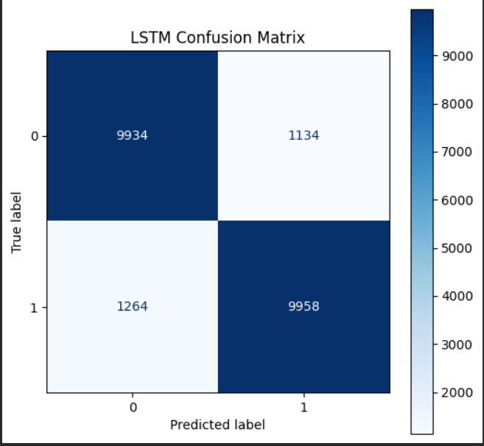
Confusion Matrix for Base Models

Slide 16
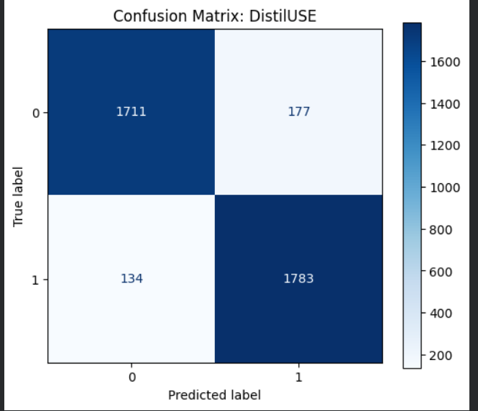
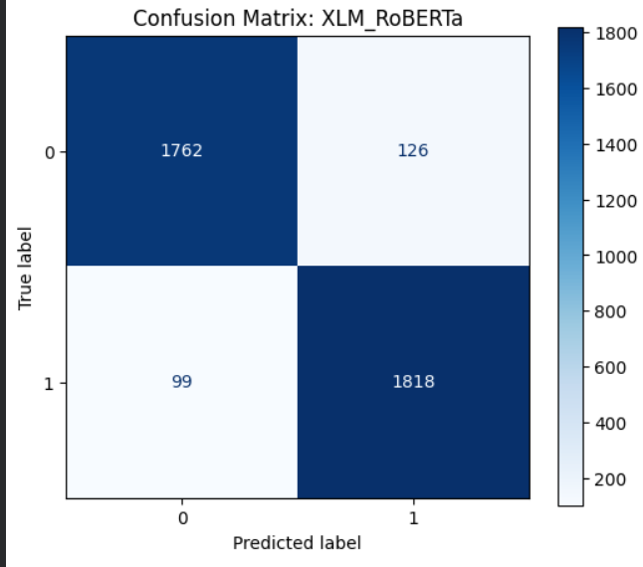
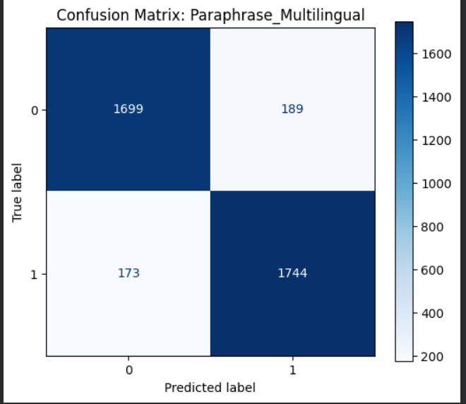
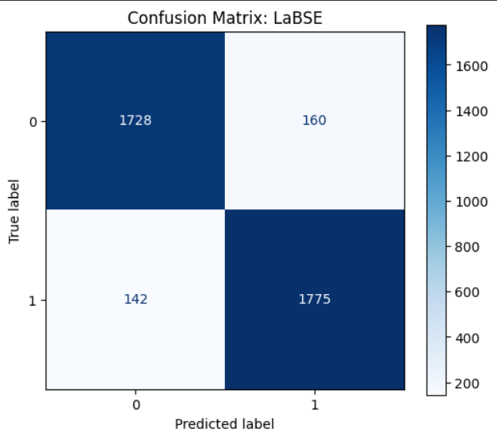
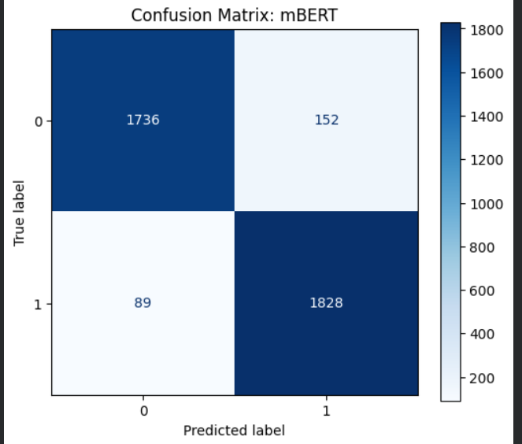
Confusion Matrix for Base Models

Slide 17
CONCLUSION
This project presents an effective approach to detecting fake news in a multilingual environment using NLP and deep learning techniques. By combining multiple datasets and applying transformer-based models, the proposed system achieves better generalization across languages compared to traditional methods. The solution is scalable, language-independent, and suitable for real-world applications such as social media monitoring and news verification.

Slide 18
Thank YOU

